Slide 1


Slide 2
Roof Coatings Product Knowledge Training

Slide 3
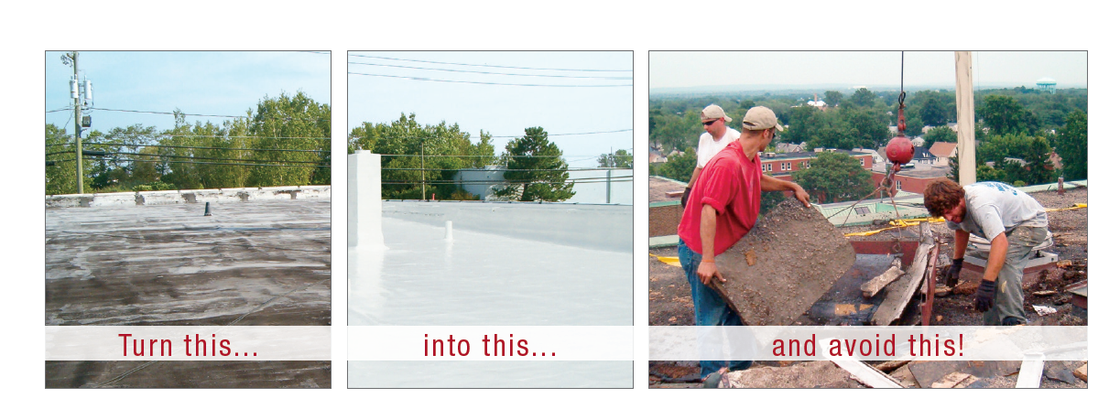

Slide 4
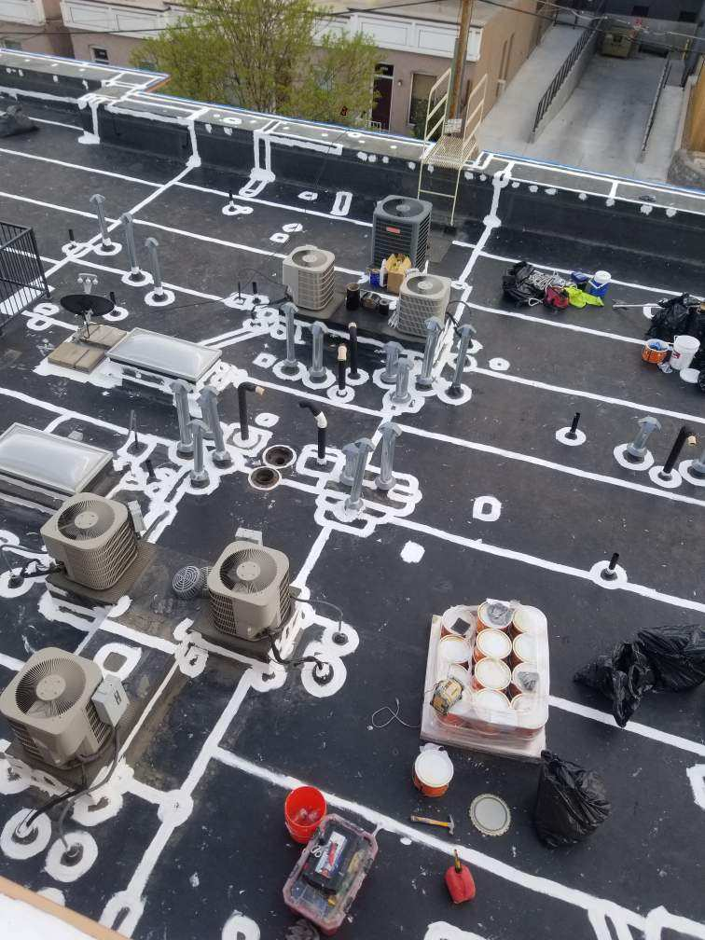
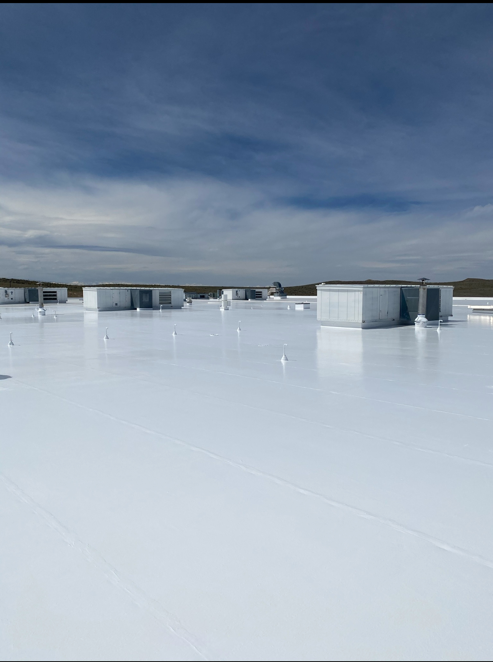
Benefits of Roof Restoration
Cost
Convenience
Liability
Environment

Slide 5
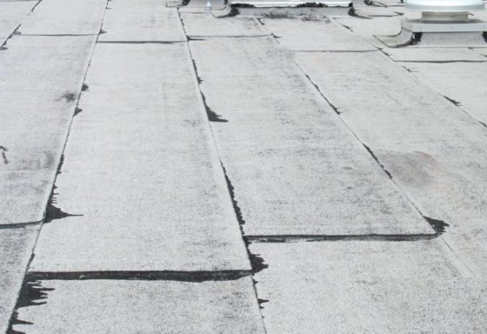
Is a Coating the Correct Option?
Roof type
Low/Steep Slope
Substrate
Existing roof condition
Water Intrusion?
Physical Damage?

Slide 6
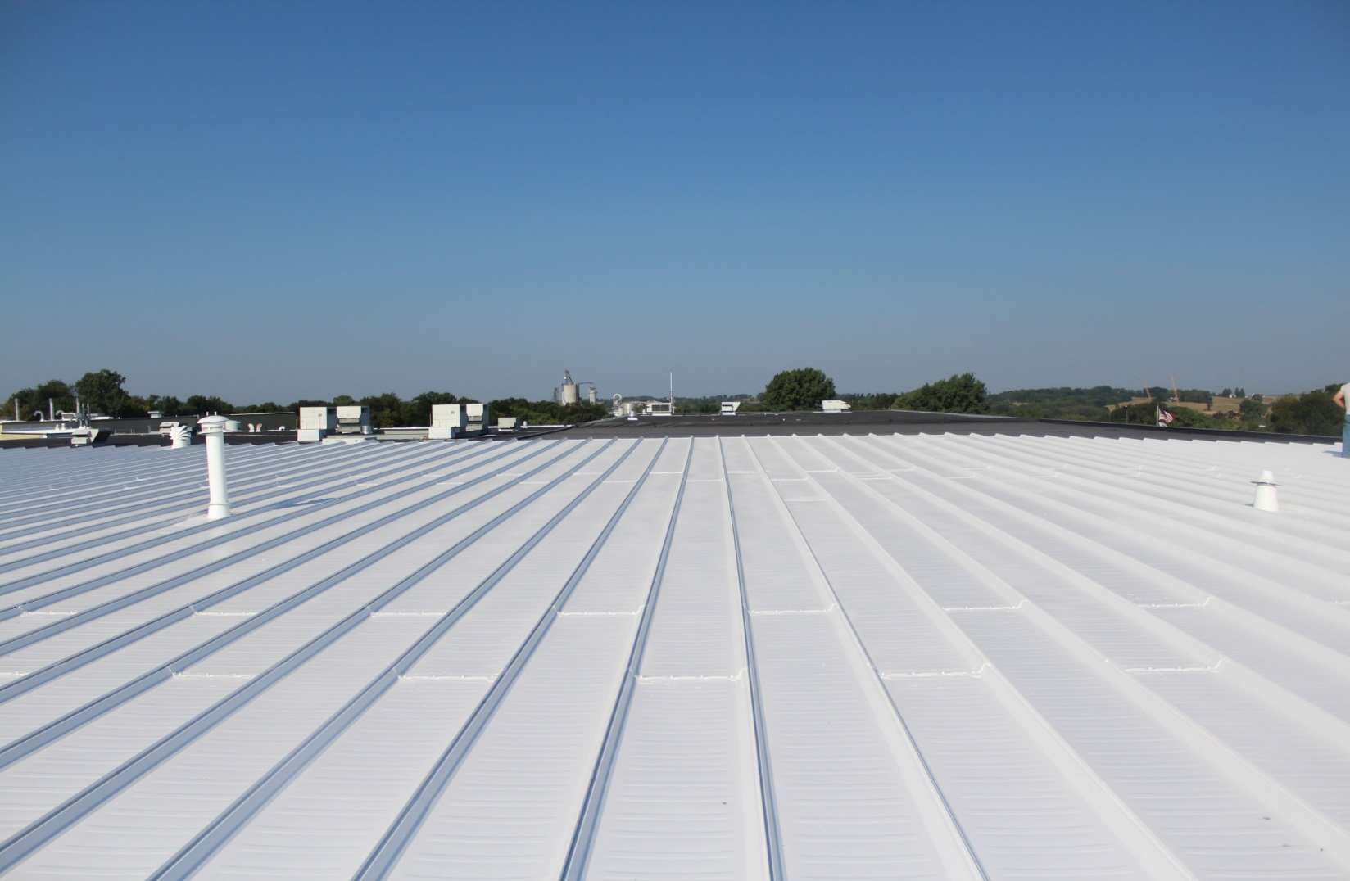

Solar Performance
88% Reflectance
87% Emittance
Energy
Notes:
The slide shows a metal roof that has been coated with GacoFlex silicone. The sun produces solar radiation. 88% of the solar radiation is reflected back. The portion of the solar radiation that remains is converted into energy (heat). That energy is then released. This is called emittance. Both reflectivity and emittance are measured from 1-100. A good coating will have a high number for both reflectance and emittance.

Slide 7
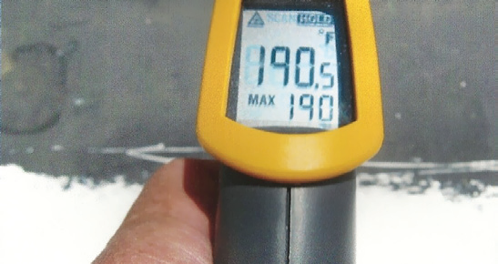
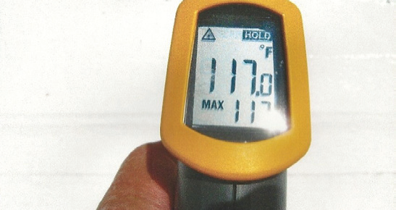
Cool Roof
Aged EPDM
Coated with GacoFlex Silicone
Notes:
The photo shows the difference in the surface temperature on a roof that is not coated vs. one that is coated with GacoFlex silicone. In many cases the surface temp of a roof that has been coated with GacoFlex silicone will be within 10 degrees of ambient temperature.

Slide 8
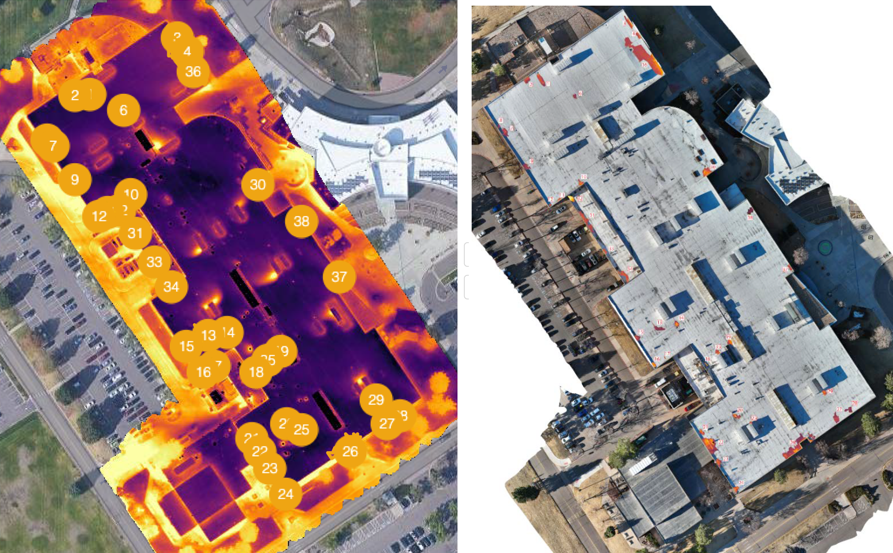
Notes:
This photo shows a thermal scan of a roof and the surrounding areas. Notice that the hottest areas are in the parking lot at the top of the photo. The coolest areas shown is vegetation. The roofs surface is between 100-110 degrees.

Slide 9
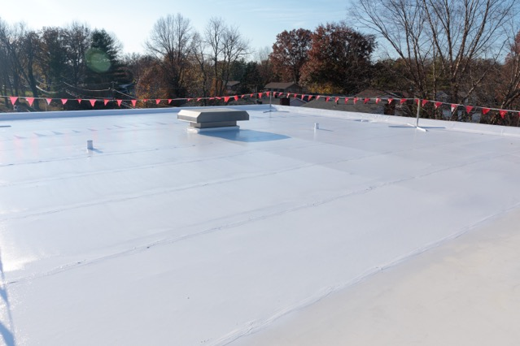
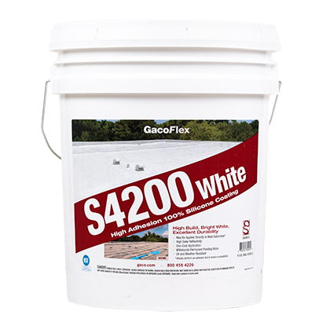
Colorado - A Silicone Market – WHY??
S42 is a high solids 100% Silicone coating that can be used to rejuvenate, repair or replace an existing system.
Approvals – FM, UL, NOA, CRRC, Miami Dade, and Title 24
No Primer required *most applications
Single coat application
Moisture cured
SF42/GacoPatch fibered mastic available
2 - year shelf life

Slide 10
Usage
As a maintenance coating for:
Pre-existing elastomeric roof coatings
Metal roofs
Built up roofing (BUR)
Mineral cap sheet
Weathered single-ply membranes EPDM, PVC, TPO
SPF Roofs (New Roof System)
Over concrete and other coatings
Notes:
GacoFlex Silicone coatings are used in a large variety of applications. As a rejuvenating maintenance coating they can restore metal roofs, BUR roof systems, mineral cap sheets and weathered single-ply membranes. They are used along with Spray Polyurethane Foam and also in concrete and existing coatings.

Slide 11
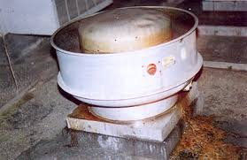
Chemical Resistance
Excellent solvent & chemical resistance.
Notes:
GacoFlex Silicones have excellent solvent and chemical resistance. However before you have a bomb go off on your roof, let us run some tests. Gaco Western has a complete R&D lab and have conducted hundreds of test both externally and internally.

Slide 12
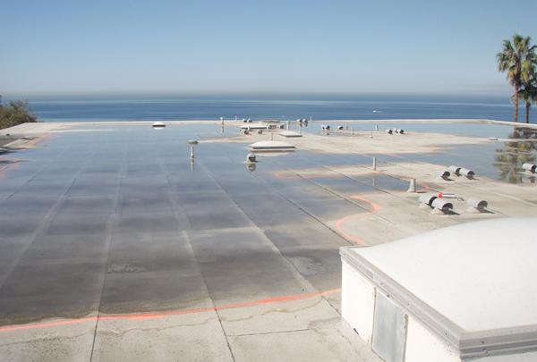
GacoFlex Silicone Coatings
will NOT FAIL under ponding water.
Notes:
Point out the scope of work that would need to be completed to re-roof or even overlay the roof with a similar system or traditional system.
New tapered system would need to be added
Drains would need to have the height changed
Edge metal would be changed adding wood nailer
New curbs would need to be installed to set the skylights at minimum height.
All this costs money.
GacoFlex silicones will not breakdown or fail under continuous ponding water. The roof in the photo has a tremendous amount of ponding water. If this roof is cleaned primed and coated according to Gaco Western specifications it will stay watertight and perform for many years.

Slide 13
Solids by Volume
After cure, only the solids will remain… so if one gallon of GacoFlex Silicone Coatings is 95% solids after cure, you will have a dry film thickness of 15.2 mils.
16 wet mil x 0.95 solids = 15.2 dry mil
Notes:
After the coatings cure only the solids will remain.

Slide 14

Solids by Volume GacoFlex Silicone vs. Acrylic Coating
16 Wet Mils
16 Wet Mils
15.2 Dry Mils
8 Dry Mils
95% Solids
50% Solids
Notes:
Based on the information learned on the previous slide, we start with 16 wet mils for both the GacoFlex silicone and the acrylic coating. Knowing that the GacoFlex Silicones are 95% solids by volume, after cure there will be a dry film thickness of 15.2 mils or 95% of 16. The acrylic coating with only 50% solids by volume will have a dry film thickness of 8 mils or 50% of 16.

Slide 15

About PCS
In business for 15 years
Largest silicone roof applicator serving the Rocky Mountain Region
50% of projects with roofing companies and property managers
Gaco and Uniflex Specialists. Certified with most other top manufacturers
Large crew equipped to handle projects of any scale
Silicone Experts

Slide 16
Silicone
Withstand PERMANENT ponding water
UV stable
White roof = reflective = energy savings
Creates seamless, monolithic roof system
Excellent hail performance
Retains mil thickness

Slide 17
Why PCS?
Free inspections
Will meet your designated contact on site
Turnkey Solutions = Peace of Mind -Conduct pre-inspection -Order and coordinate material -Schedule final inspection -Provide daily progress photos
Strictly a coatings company

